Slide 1
HW Requirements
Laptop
Power adapter

Slide 2
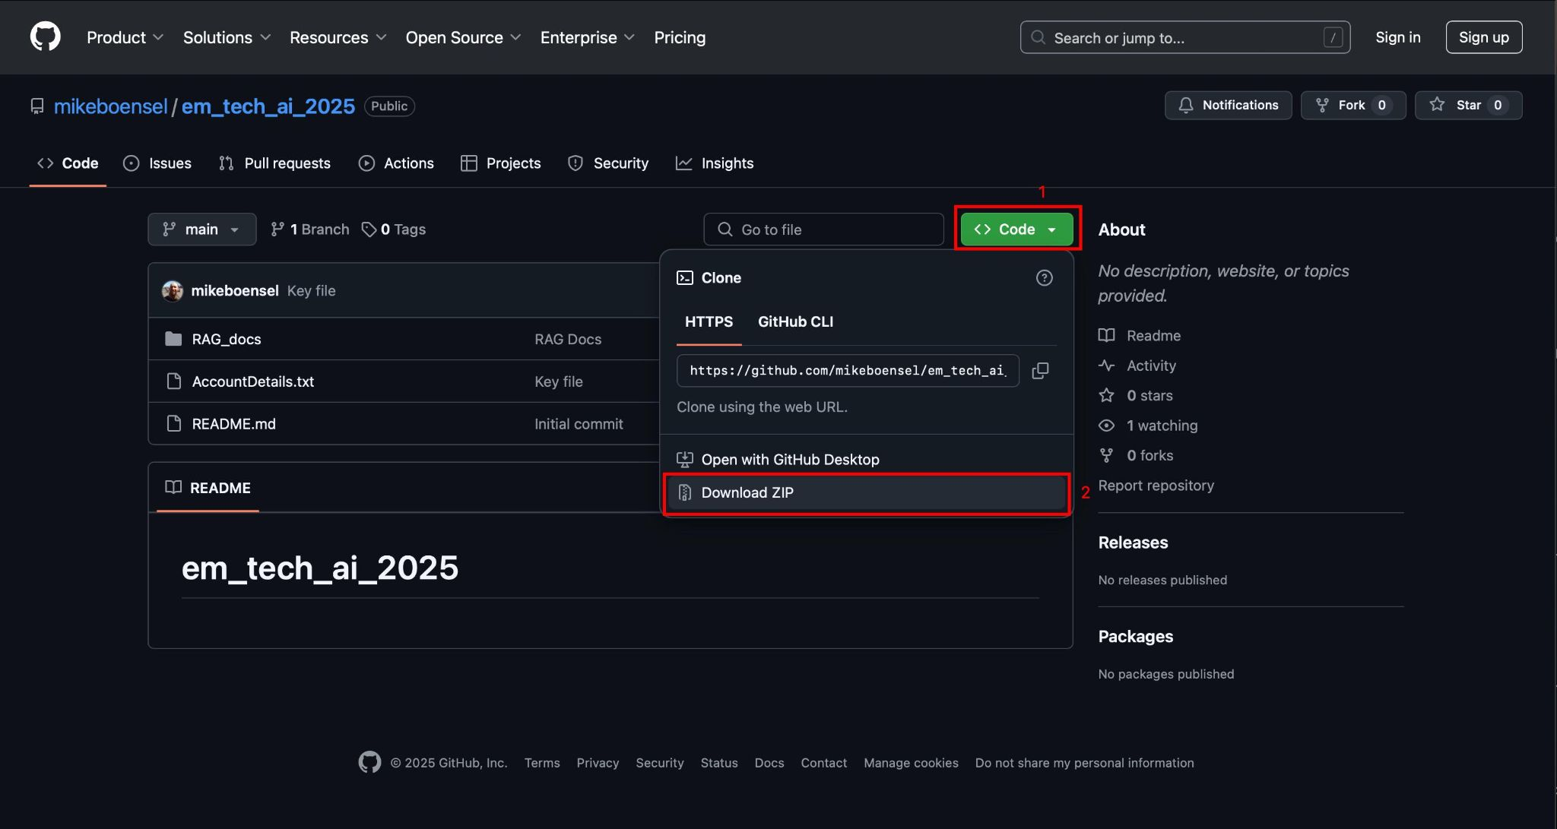
SW Requirements
A web browser
Download the repo here (see screenshot below)
Open the ZIP you just downloaded

Slide 3
Account Requirements
We need the following accounts:
OpenAI
Replit
AirTable
We need to get specific values from these accounts for later use. You will be adding these values to AccountDetails.txt from the ZIP file we downloaded.

Slide 4
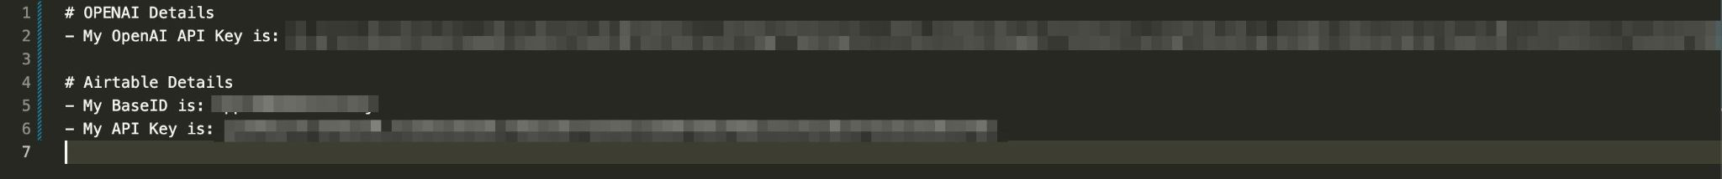
AccountDetails.txt
We need to get specific values from these accounts for later use.
Initially the file has no values in it, just placeholders
The end state of this file should be this:
Note: All values should be treated like passwords and you should never share (except with workshop TAs!), hence the blurring out I did

Slide 5
Replit Setup

Slide 6
Replit Account setup (1)
Click here to signup
Login if you have an account already.
If you do not have an account you will need to create one. The process is straightforward.

Slide 7
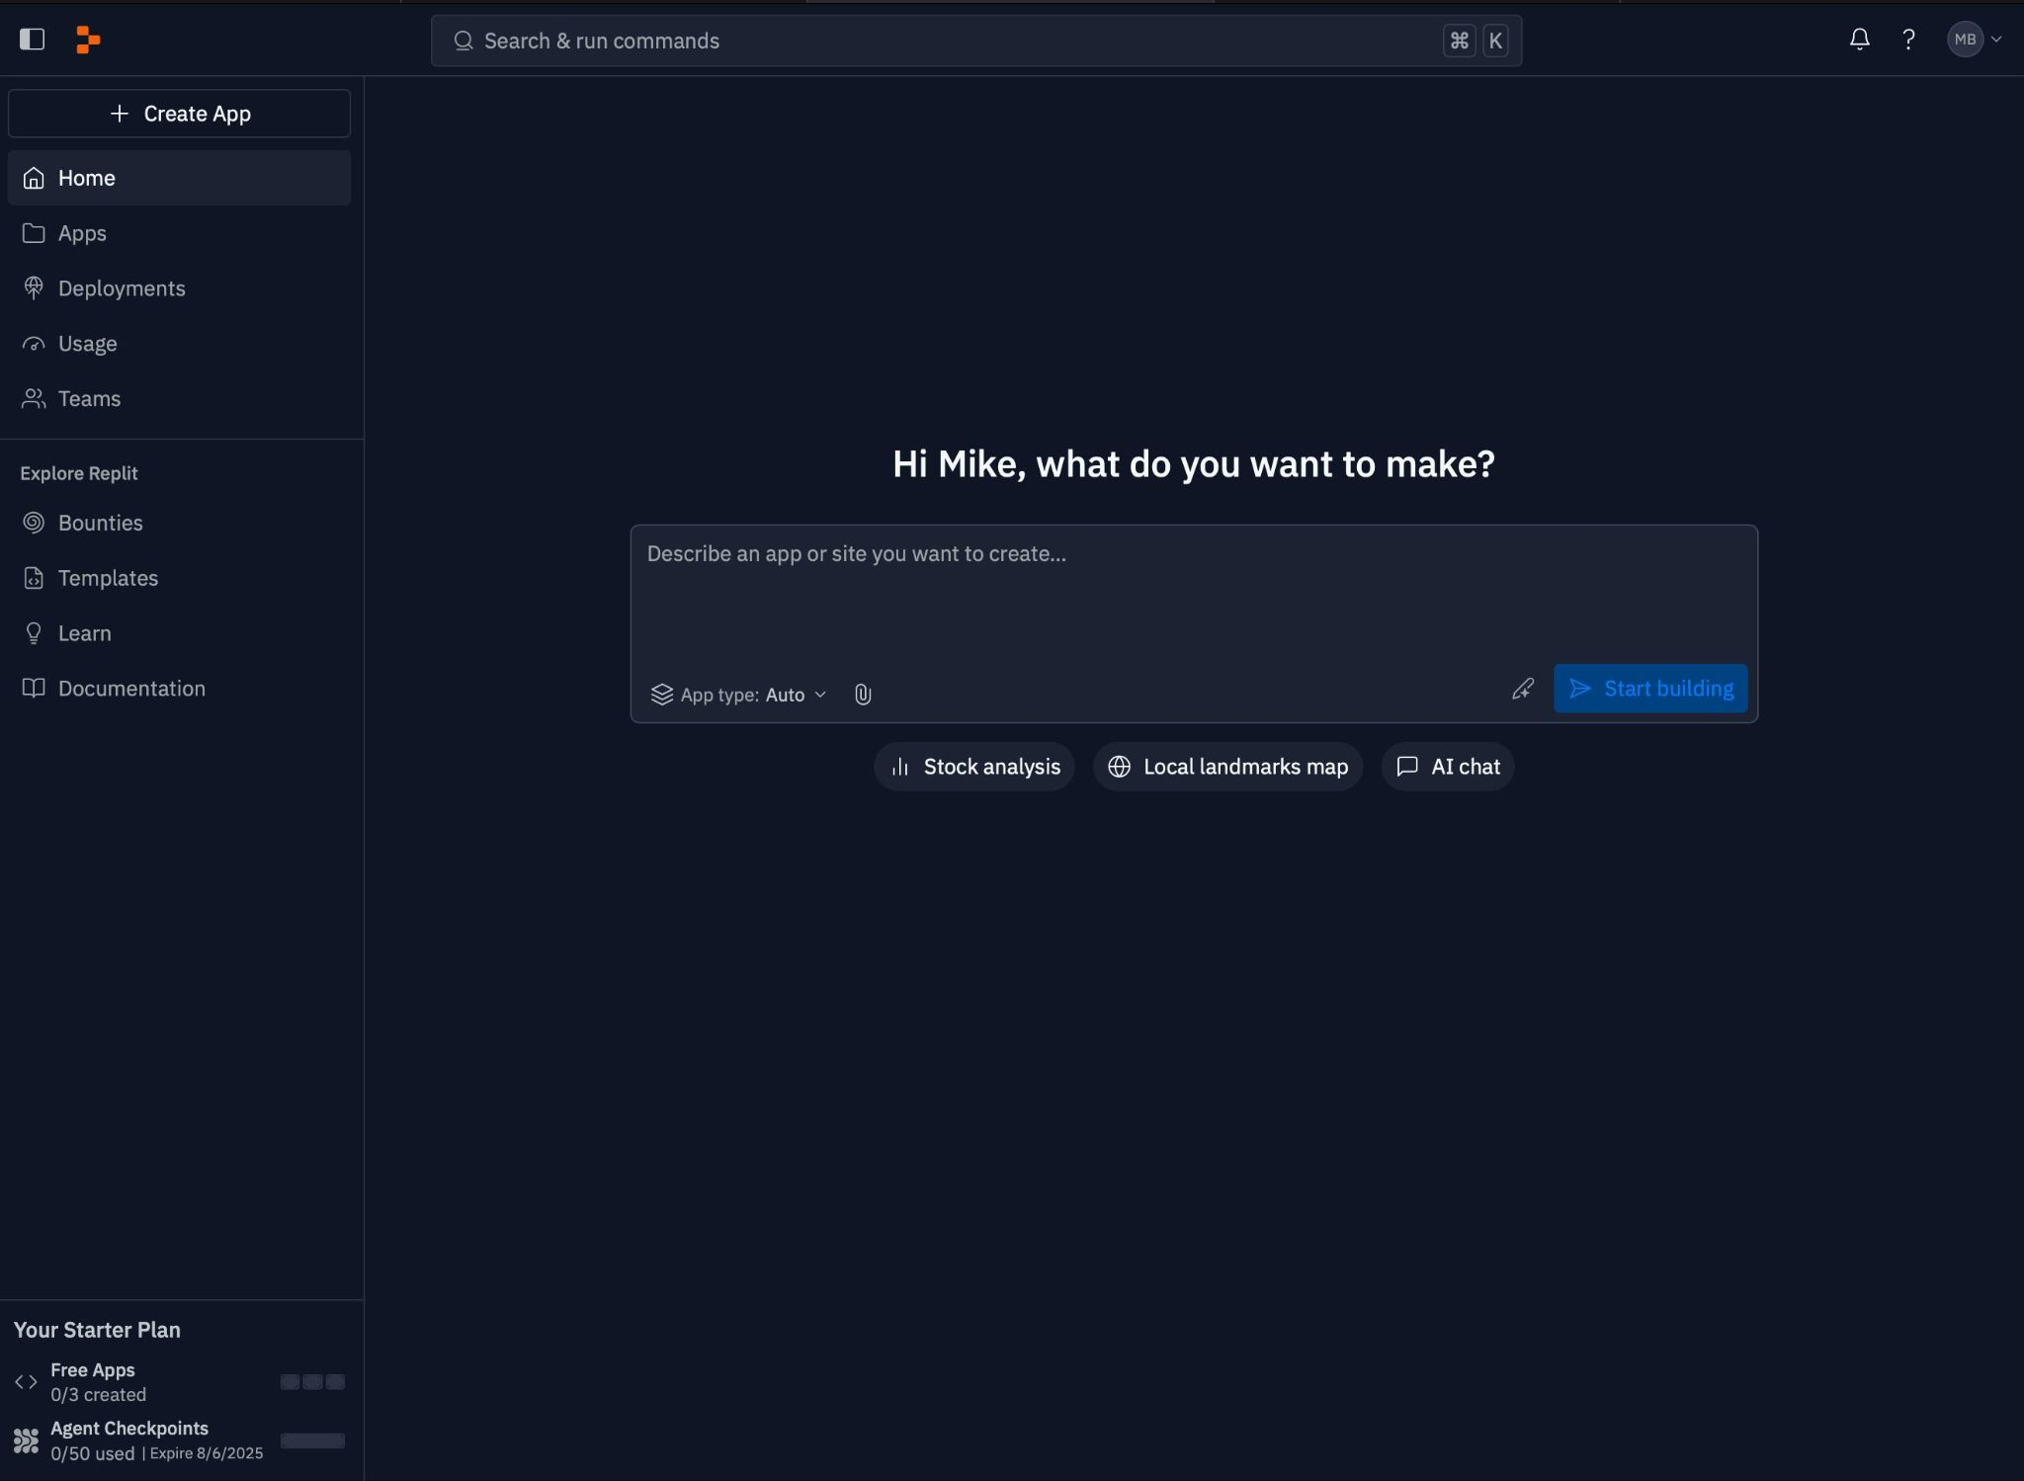
Replit Account setup (2)
You must verify your email to begin using the Replit account.
You should be presented with a UI that looks like this (possibly not in dark mode):

Slide 8
OpenAI Setup

Slide 9
OpenAI Account setup
Log in or create your account
Click here to access the openai platform
Login if you have an account already.
If you do not have an account you will need to create one. The process is straightforward.

Slide 10
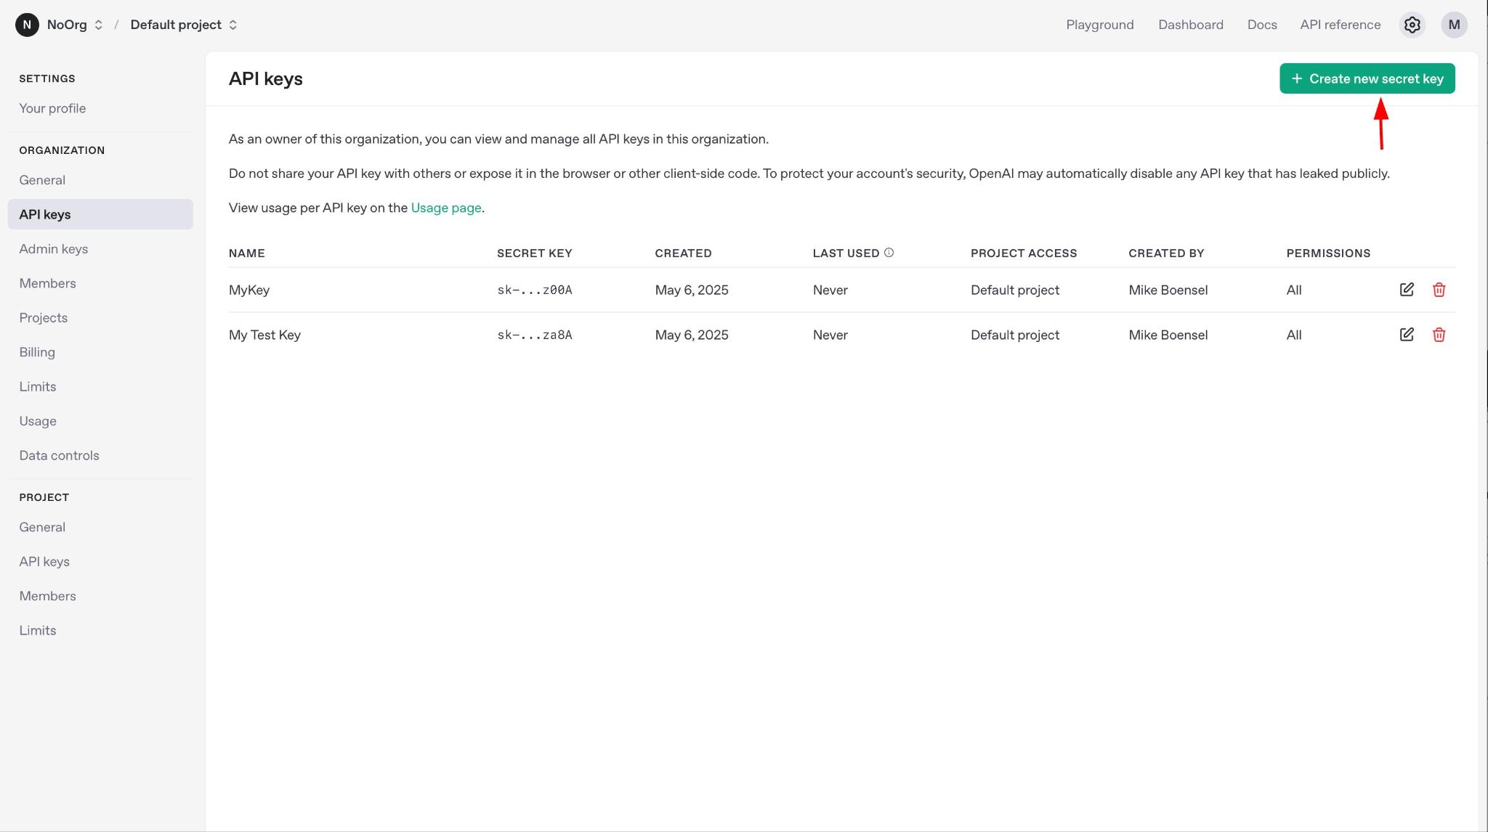
OpenAI API Key creation
We want to create an API Key. What is API key?
Authentication mechanism for accessing services
Like a password, but unique, safer, and easily revokable
Get your OpenAI API Key (Step 1)
Open this link
Click the “Create New Secret Key” button

Slide 11
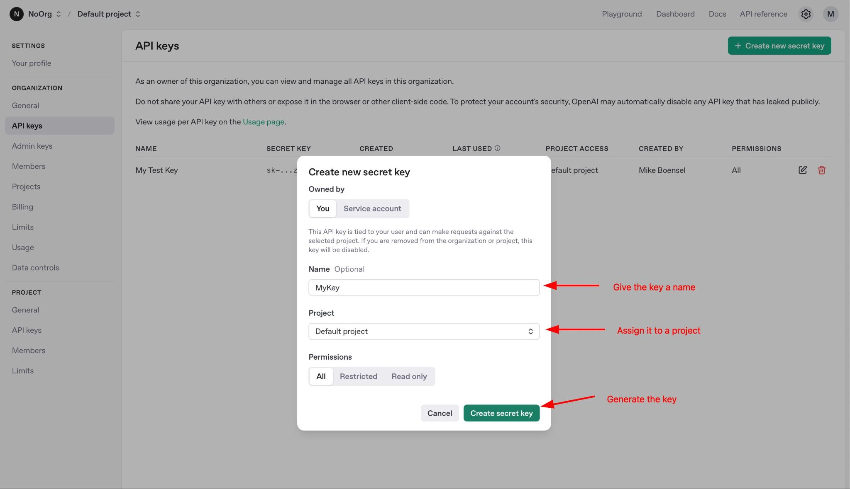
OpenAI API Key creation (2)
Get your OpenAI API Key (step 2)
Give your key any unique name
Select ‘Default Project’,
Click the ‘Create Secret Key’ button

Slide 12
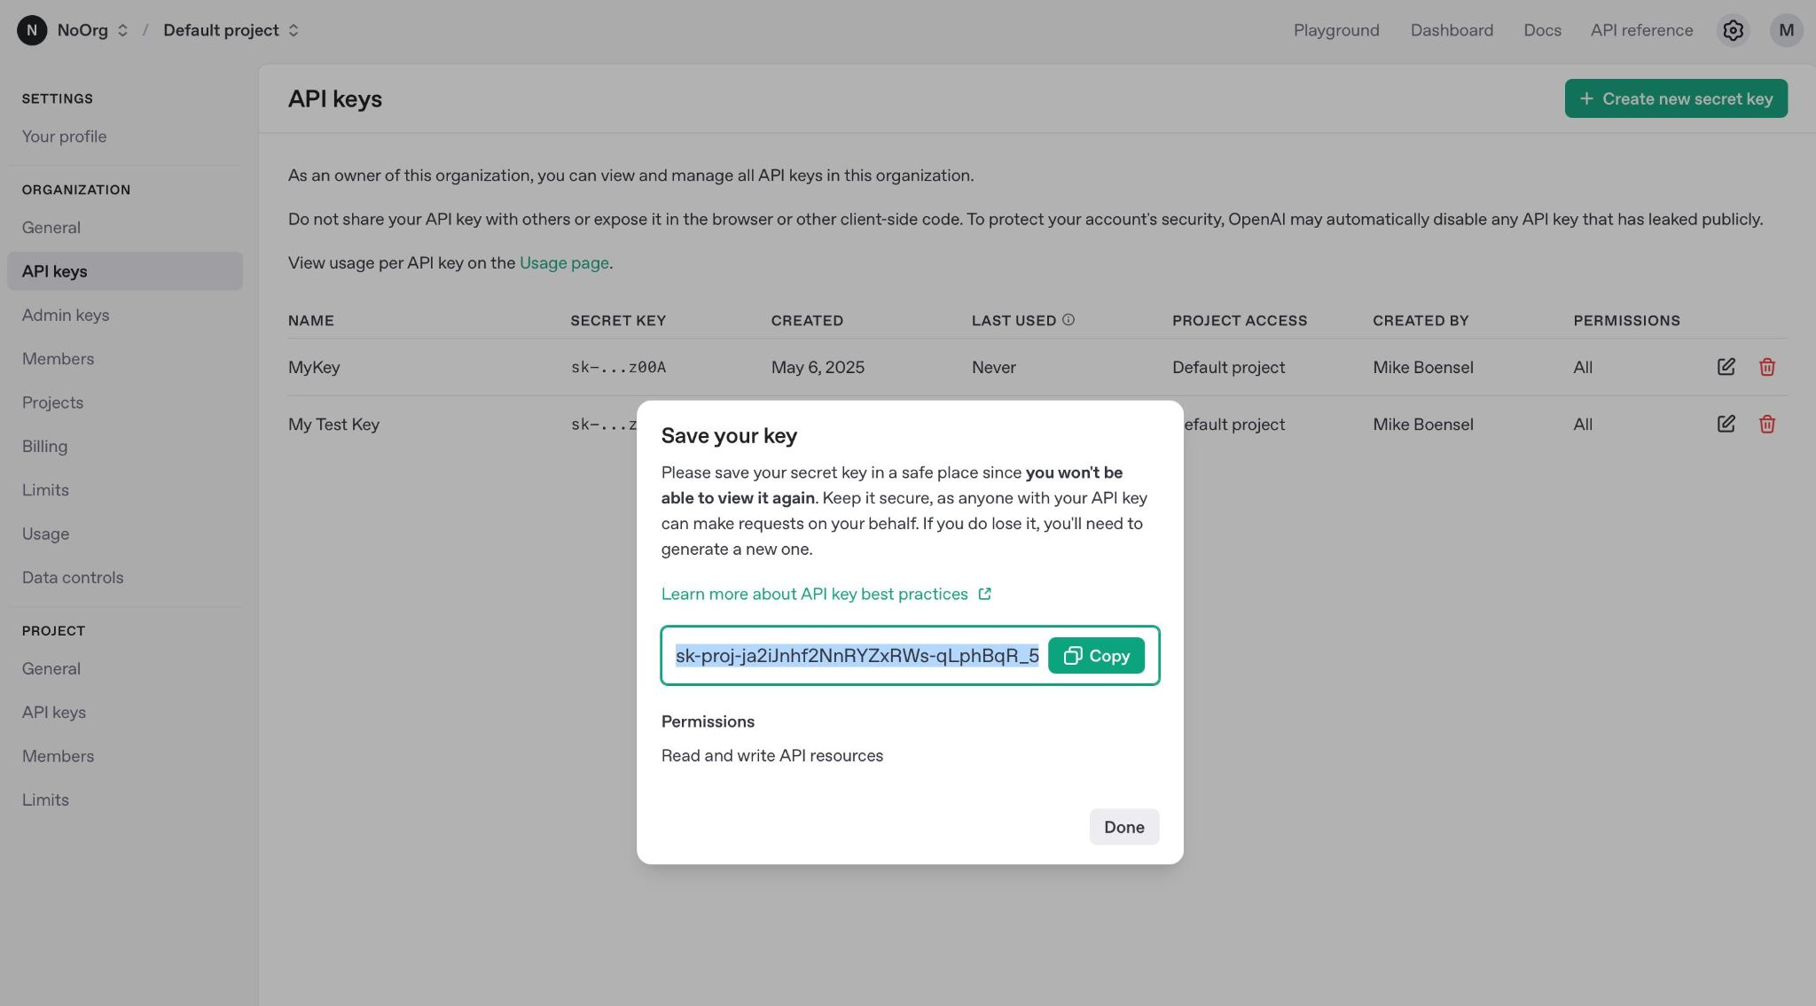
OpenAI API Key creation (3)
Get your OpenAI API Key (Step 3)
Save this key in AccountDetails.txt

Slide 13
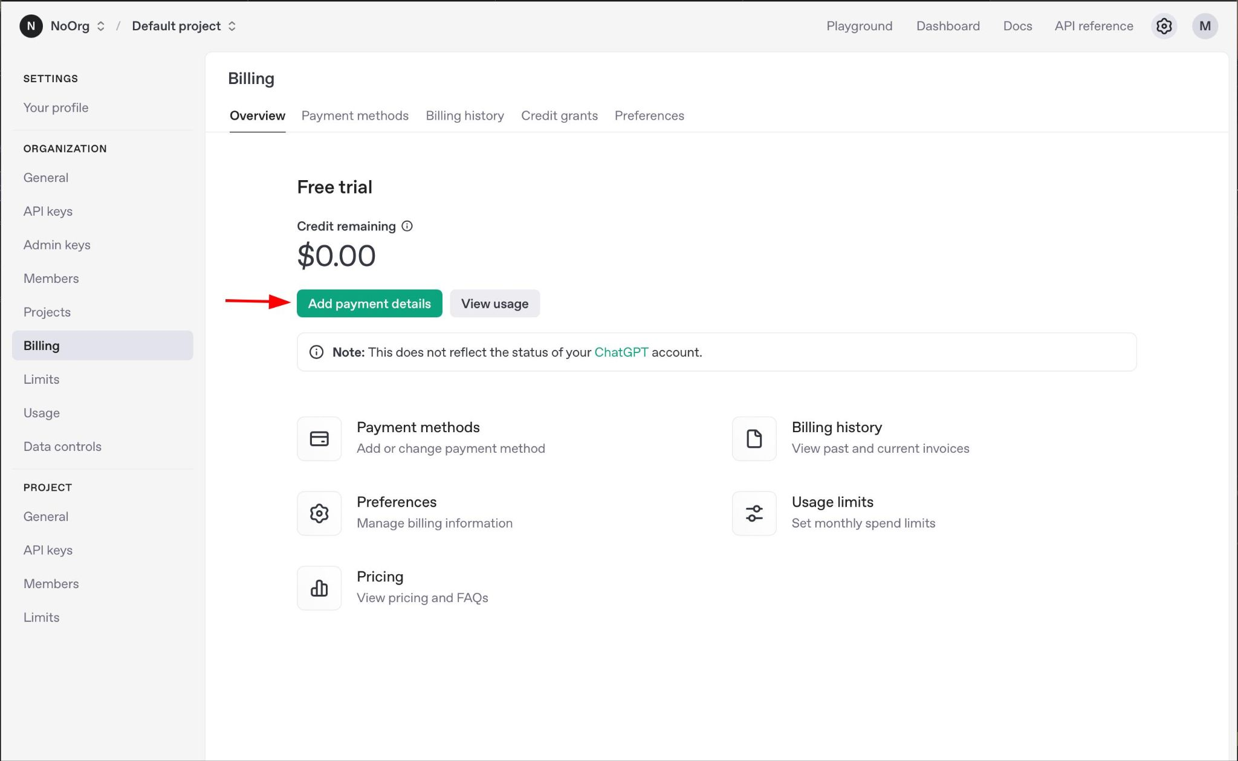
OpenAI (Funding your account)
Add a payment method
Fund the account
$5 will be plenty for the workshop

Slide 14
Airtable Setup

Slide 15
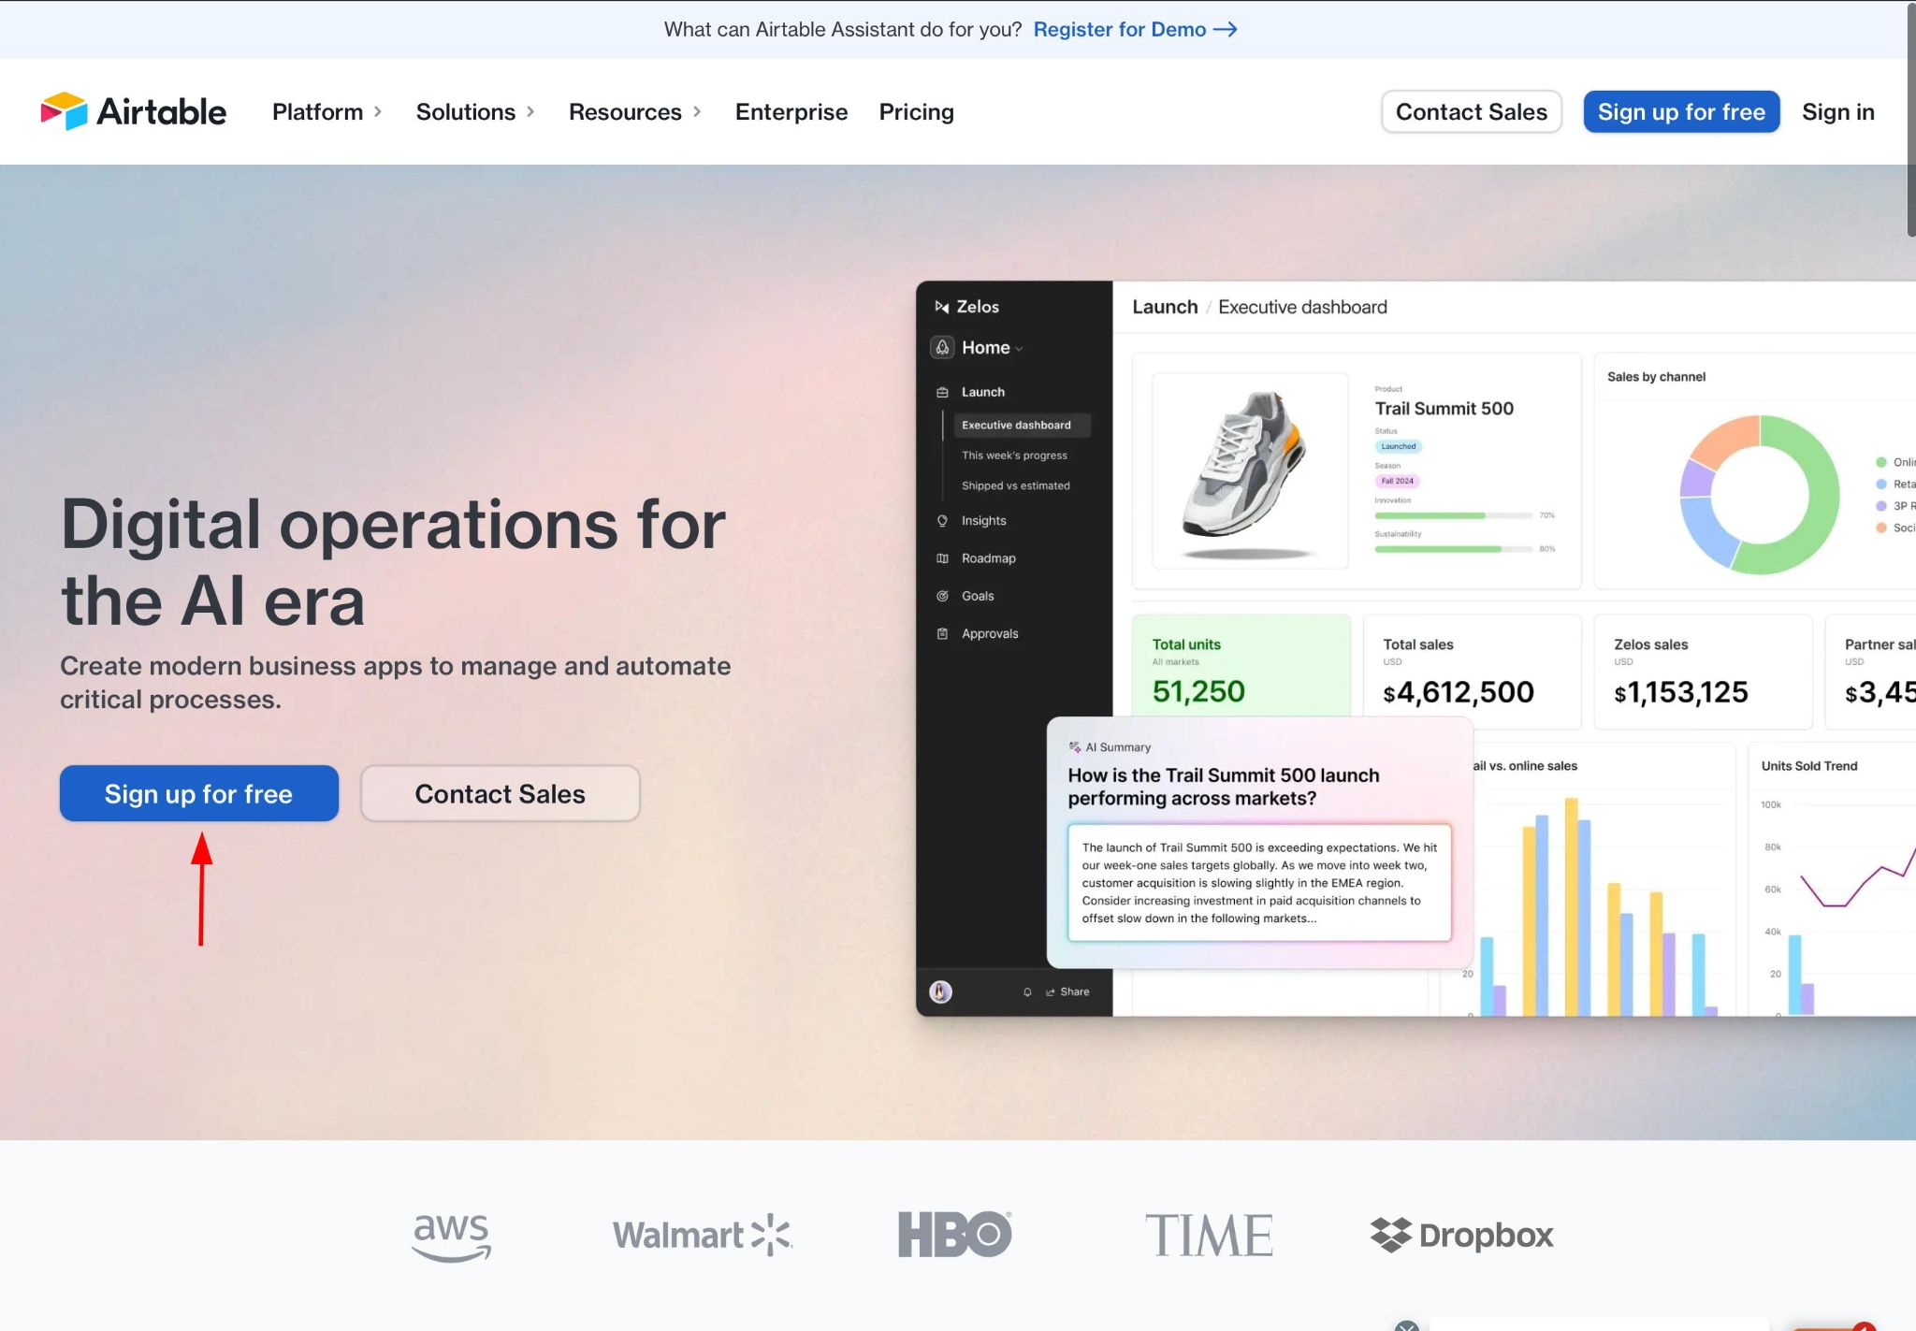
Airtable (Account creation)
Create an Airtable account via this link
Click on “Sign up for free”.
You will be presented with a bunch of info gathering spam. Answer however you want. None of this impacts our use case

Slide 16
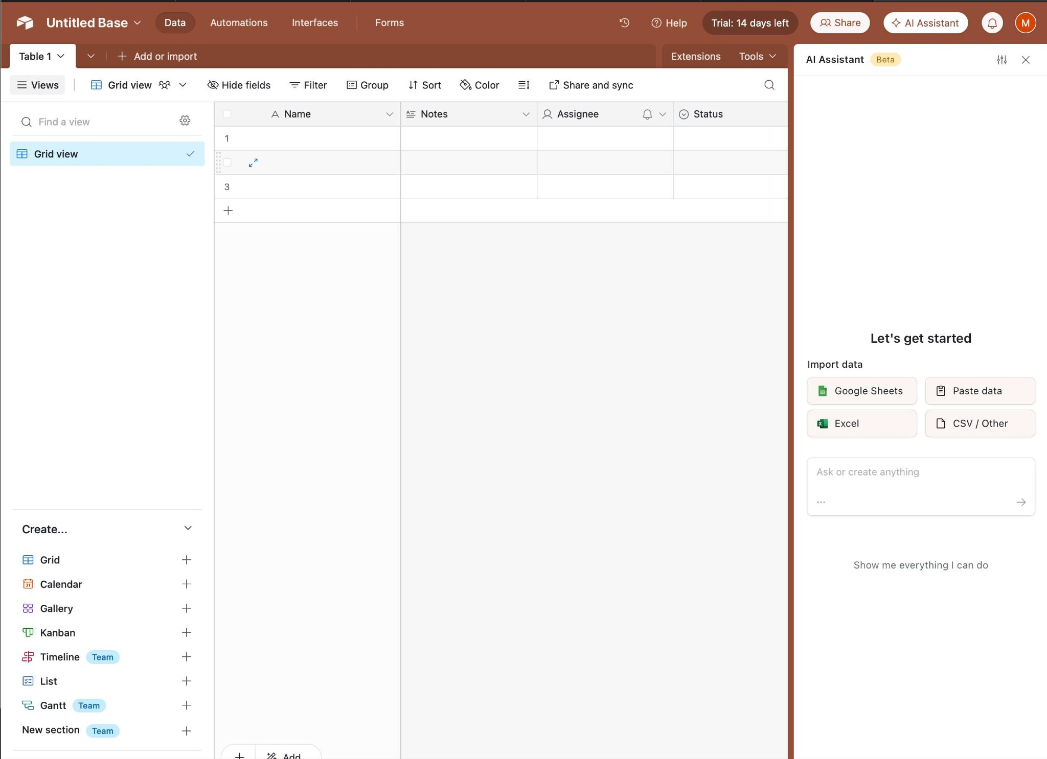
Airtable (Account creation (2))
On successful account creation you should now see this screen:

Slide 17
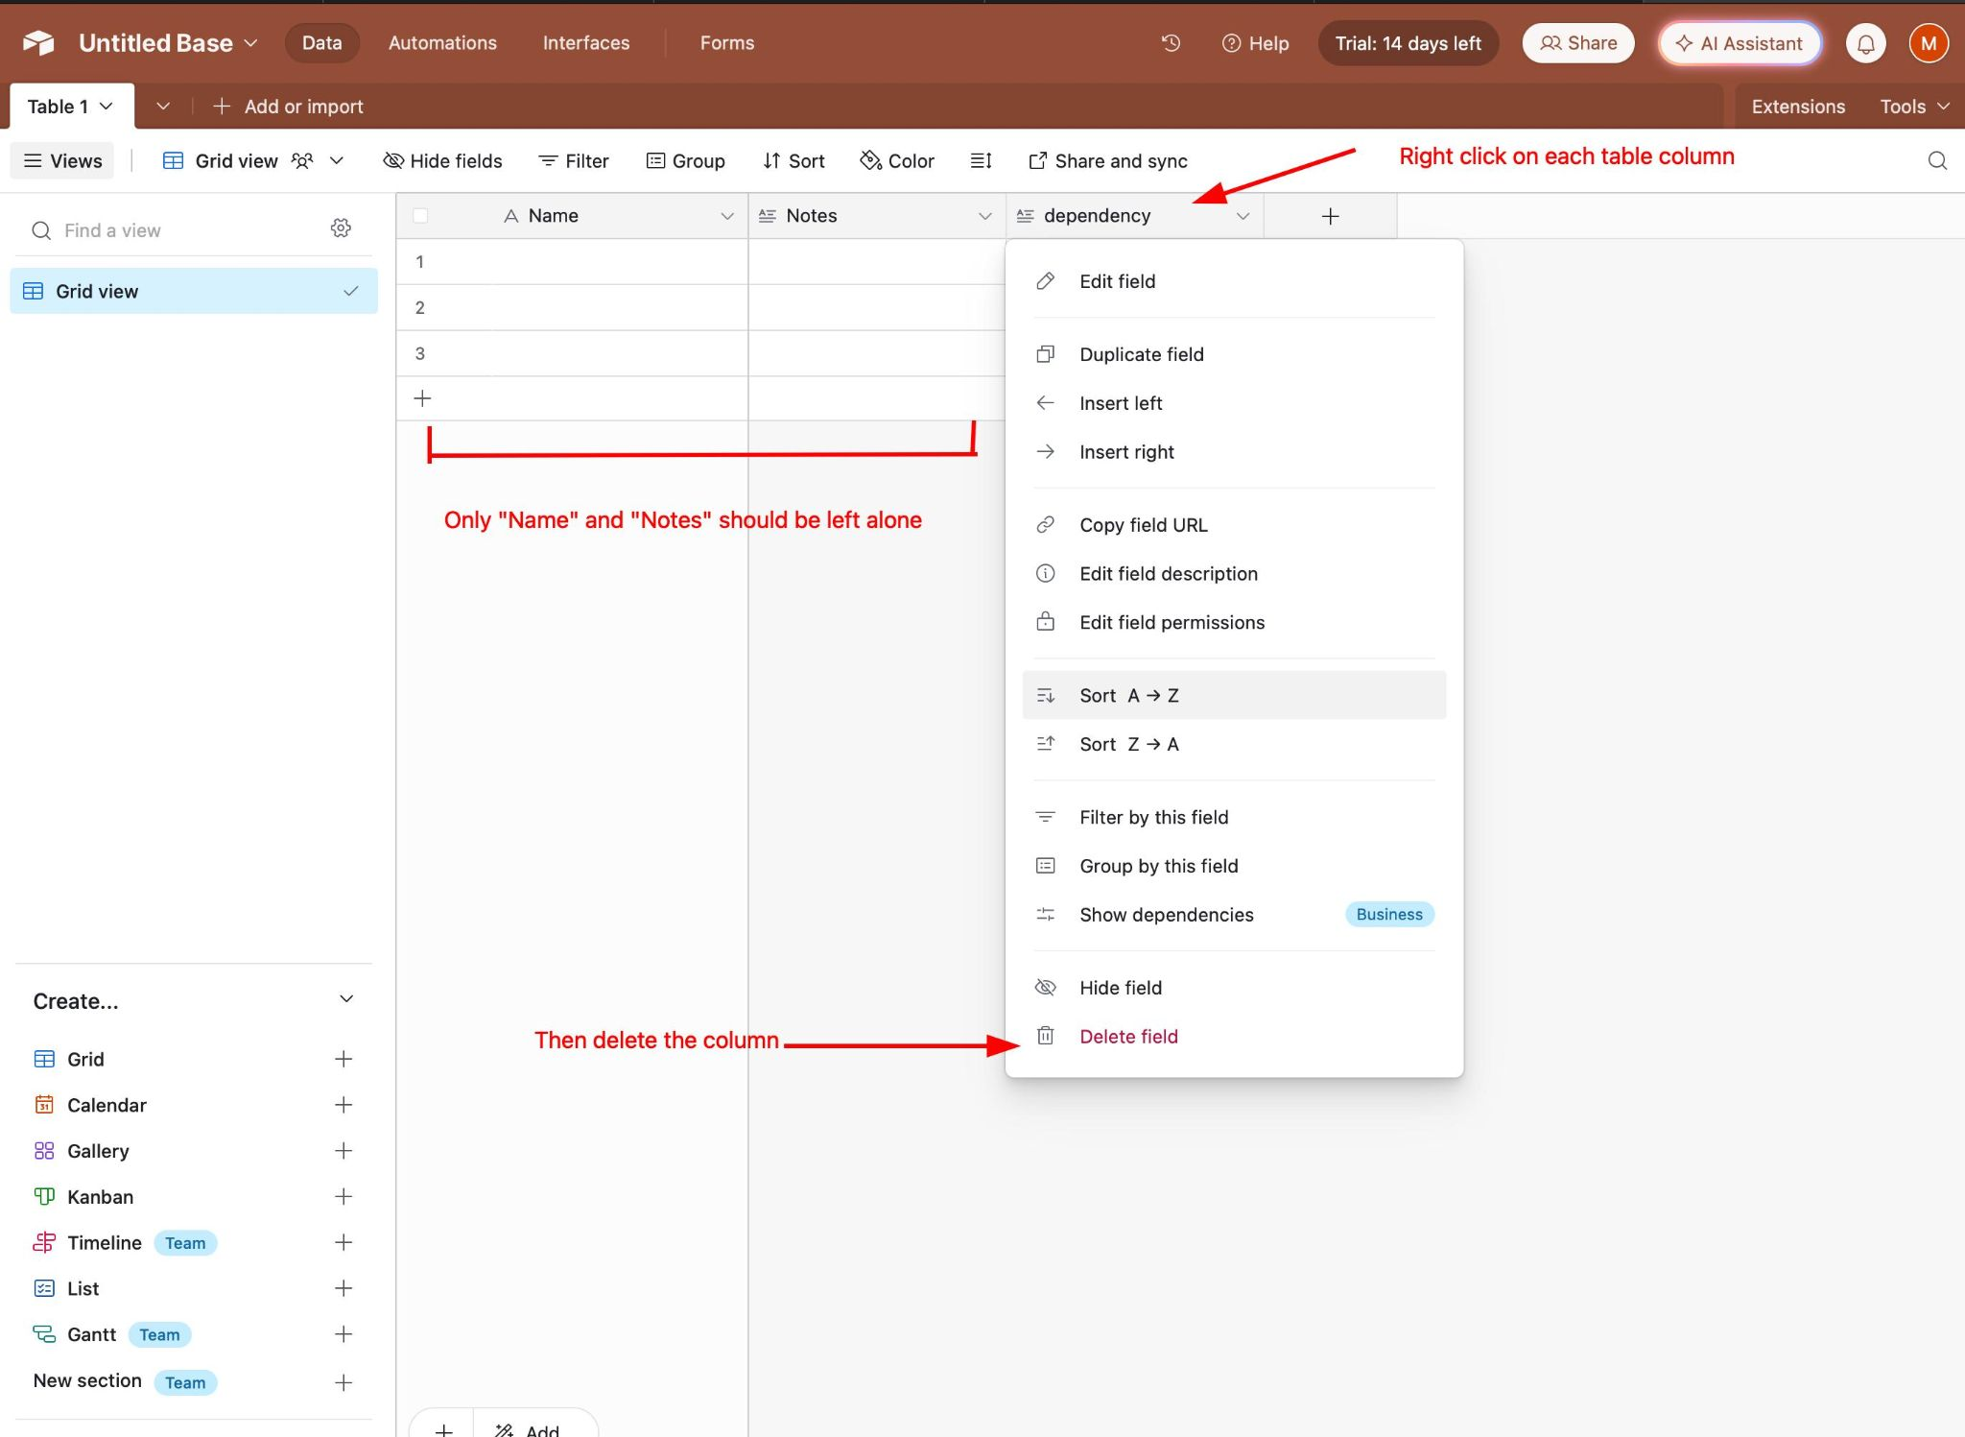
Airtable (Table setup)
Edit the default table to remove all columns except “Notes” and “Name”.

Slide 18
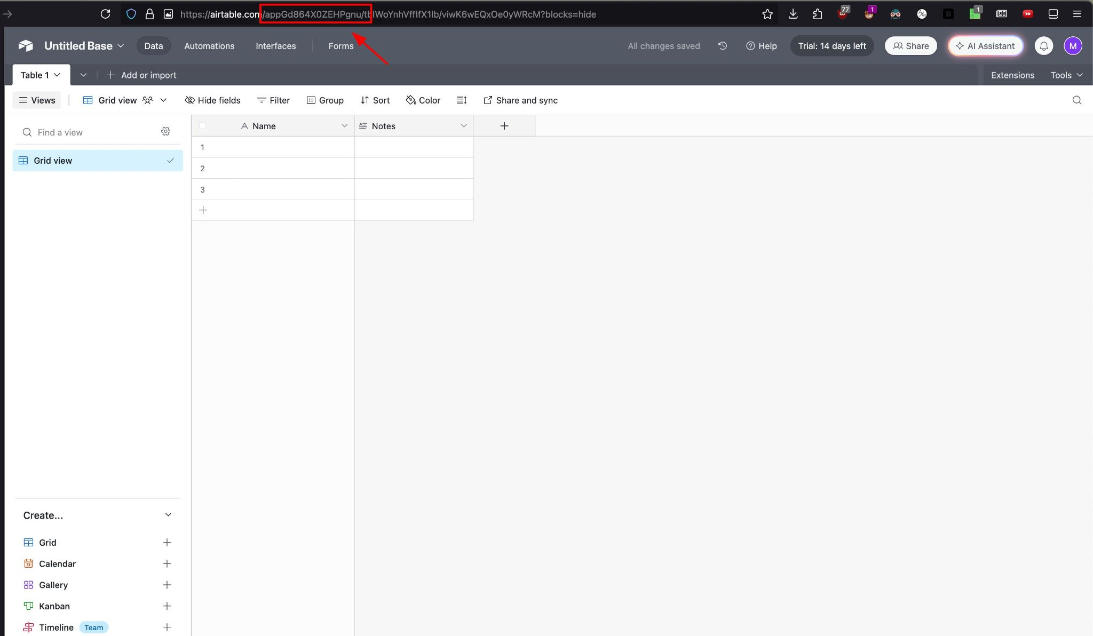
Airtable (Get the Table ID)
The Base ID from your Airtable Table appears in the URL bar. It should be of the form: appxxxxxxx . It is everything within the bounds of the / characters
In the image, my Base ID was: appGd864X0ZEHPgnu
Save this in AccountDetails.txt

Slide 19
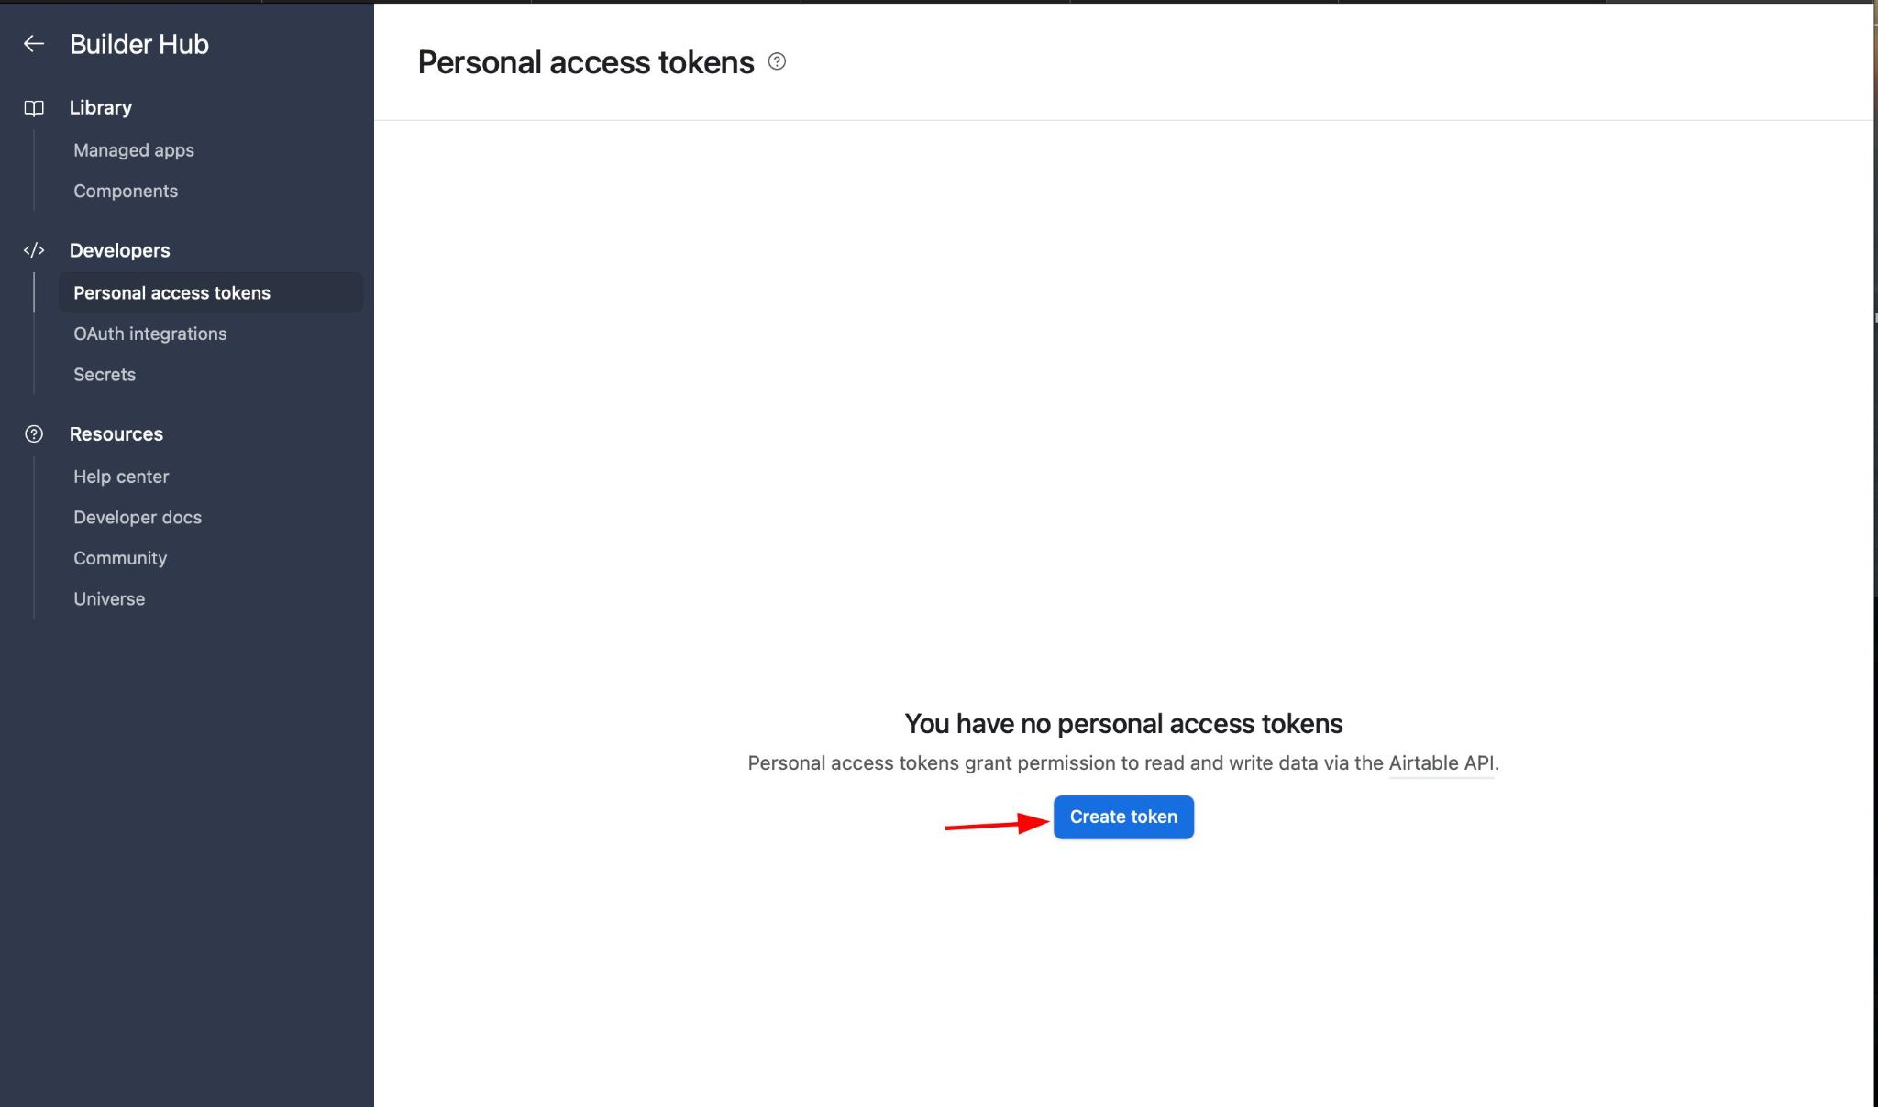
Airtable (Get the API Key (1))
Verify your email (there should be an email that Airtable has sent to you w/ a link in it). Without doing this you cannot create an API Key
Go to this link and click on “Create new token”

Slide 20
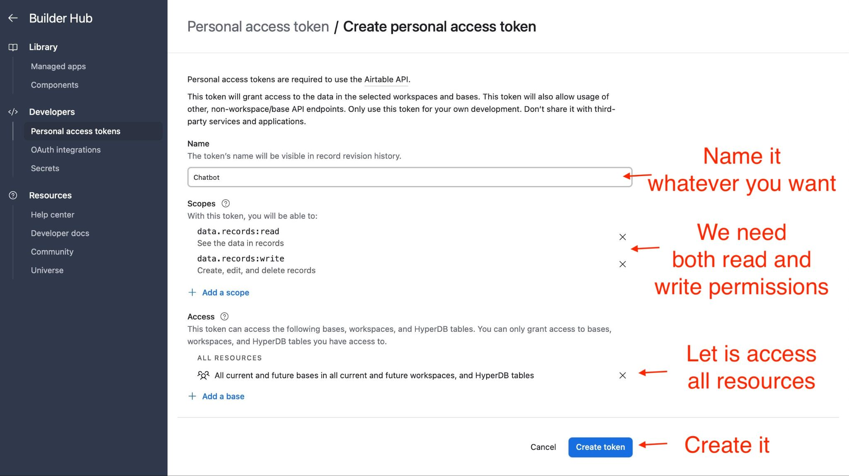
Airtable (Get the API Key (2))

Slide 21
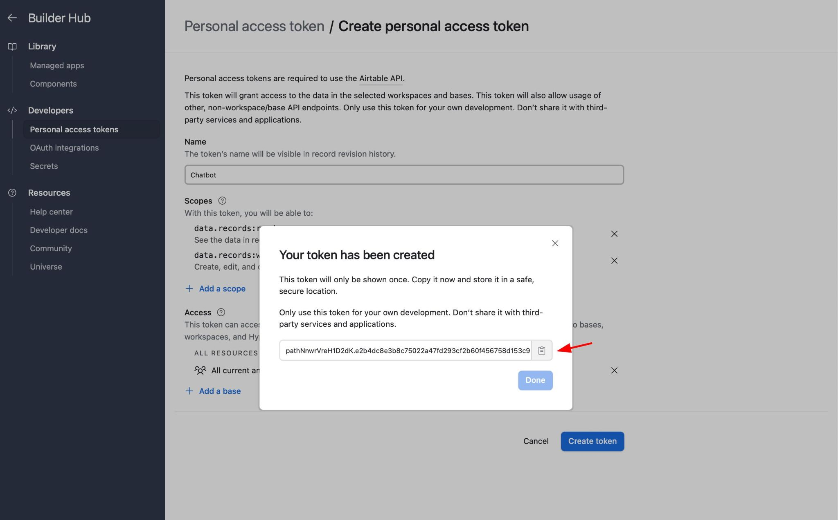
Airtable (Get the API Key (3))
Copy your API Key and save it in AccountDetails.txt

